Slide 3
Unit 8: Celebrations
Lesson 1: Getting started
& Listen and read

Slide 4
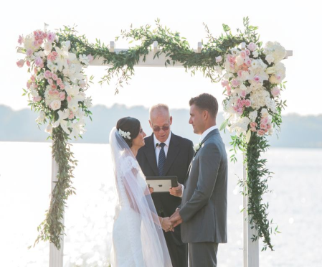
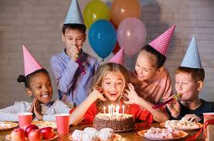
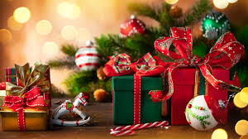
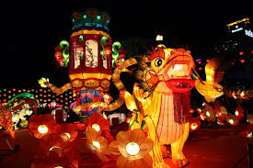
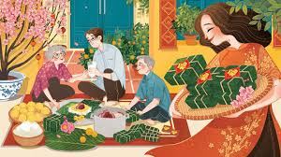
I. GETTING STARTED
Easter
Lunar New Year
Christmas
Easter
Wedding
Birthday party
Birthday party
Mid-Fall Festival
wedding
Christmas
Mid-Fall festival
Lunar New Year

Slide 5
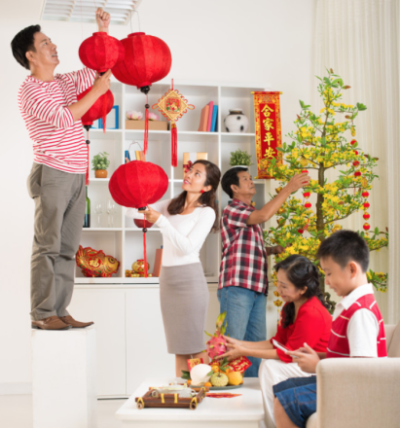
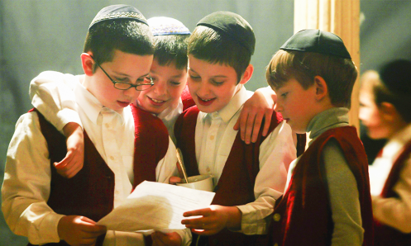
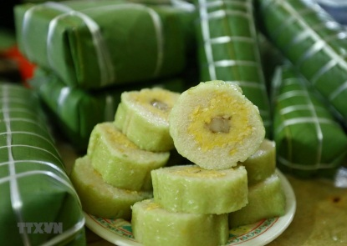
II. VOCABULARY
1. Celebration (n)
celebrate (v)
2. Occur (v) = happen
3. Decorate (v)
4. Sticky rice cake (n)
5. Live apart
6. Jewish people
Lễ kỉ niệm
Lunar new year is the most important
celebration in Vietnam.
This festival occurs in late January or
early February
Most people decorate their
homes before Tet.
Family members who live apart
try to be together at Tet.
Kỉ niệm
xảy ra
Trang trí
bánh chưng, bánh nếp
Sống xa nhau
Người Do thái

Slide 6
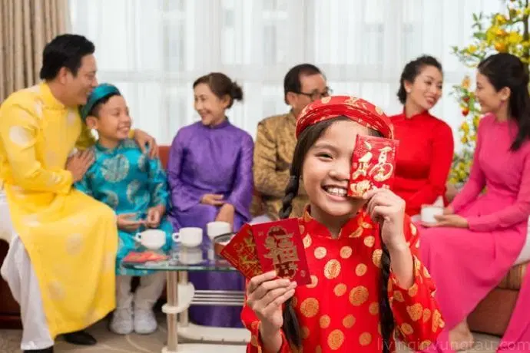
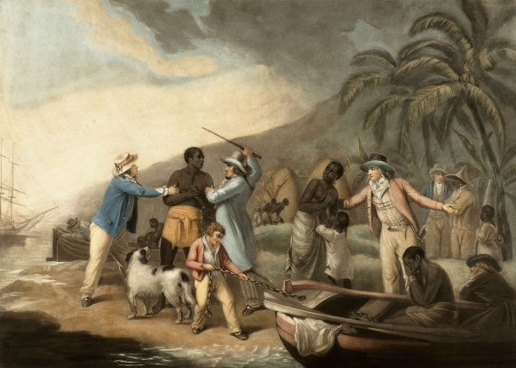
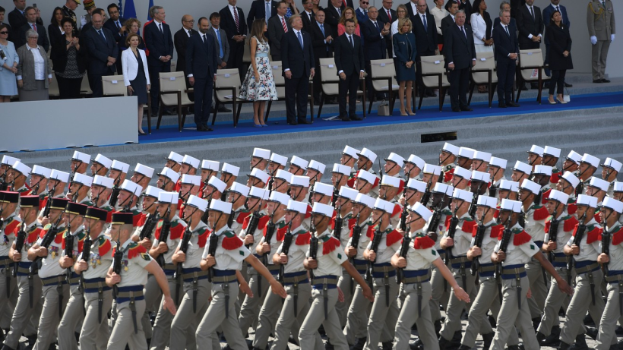
II. VOCABULARY
7. Slavery (n)
slave (n)
8. Parade (n)
9. joy (n)
joyful (adj)
10. Receive (v)
Sự nô lệ
Easter is a joyful festival which is
celebrated in many countries.
Children are eager to receive red
envelopes at Tet.
Người nô lệ
Cuộc diễu hành
Niềm vui
Vui mừng
Nhận

Slide 7
1. Celebration (n)
celebrate (v)
2. Occur (v) = happen
3. Decorate (v)
4. Sticky rice cake (n)
5. Live apart
6. Jewish people
7. Slavery (n)
slave (n)
8. Parade (n)
9. joy (n)
joyful (adj)
10. Receive (v)

Slide 8
II. VOCABULARY
Occur
Parade
Celebration
Decorate
Live apart
Sticky rice cake
Slavery
joyful
Receive
Jewish people
a. nhận
b. bánh chưng, bánh nếp
c. cuộc diễu hành
d. xảy ra
e. trang trí
f. người Do thái
g. vui mừng
h. sống xa nhau
i. lễ kỉ niệm
j. sự nô lệ

Slide 9
II. VOCABULARY
_ewi_h
re_ _ i_e
d_c_r_t_
_ _ y_ul
_l_ve_y
_cc_r
_ar_de
_ _le_rat_on
Jewish
Slavery
Occur
Receive
Parade
Decorate
Joyful
Celebration

Slide 10
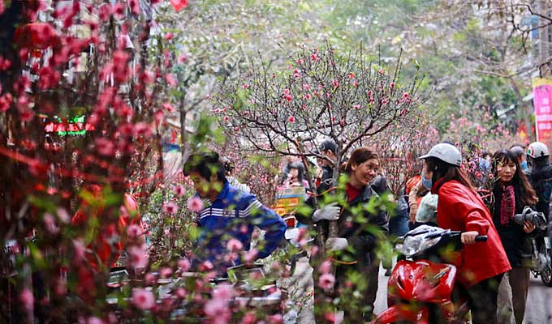
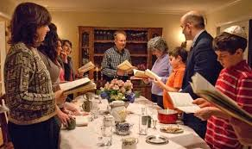
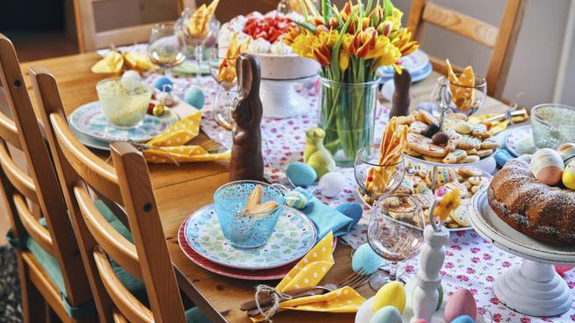
III. READ
Read the text page 65 + 66
Tet
Passover
(Lễ quá hải)
Easter
(Lễ phục sinh)

Slide 11
III. READ
Although there are many celebrations throughout the year, Tet or the Lunar New Year holiday is the most important celebration for Vietnamese people. Tet is a festival which occurs in late January or early February. It is a time for families to clean and decorate their homes, and enjoy special food such as sticky rice cakes. Family members who live apart try to be together at Tet.
Passover is in late March or early April. This festival is celebrated in Israel and by all Jewish people. On this festival, people celebrate freedom from slavery. Passover is also an ancient spring festival. On the first and second nights of Passover, Jewish families eat a special meal called the Seder.
Easter is a joyful festival which is celebrated in many countries. It happens at around the same time as Passover. On Easter Day (Easter Sunday), young children receive chocolate or sugar eggs - as long as they are good. In many countries, people crowd the streets to watch colorful parades.

Slide 12
III. READ
Celebrations | When? | Activities | Food | Country
- clean,
decorate homes,
- enjoy special food
- sticky rice cakes
Tet
- in late January or early February
Vietnam
- special meal called the Seder
- late March
or early April
Israel
Passover
- around the
same time as
Passover
- people crowd the streets to watch colorful parades
- chocolate or sugar eggs
in many countries
Easter

Slide 13
1. We are going to _______the anniversary of our 50th wedding.
A. celebrating B. celebrated C. celebrate D. to celebrate
2. She cried with _______ when she heard the new. It was her _______ time.
A. joy /joyful B. joyful /joy C. joyfully/ joy D. joy/ joyfully
3. Passover is celebrated in Israel and by all _______ people.
A. Vietnamese B. English C. Jewish D. Japanese
4. Tet is a festival _______ occurs in late January or earl, February.
A. who B. which C. whom D. when
5. At Tet, all the family members _______live apart try to get together.
A. who B. whom C. which D. whose
6. At Passover, Jewish families eat a special _______ called the Seder.
A. celebration B. festival C. party D. meal
7. On Easter Day, people crowd the streets to watch colorful _________.
shows B. programs C. contests D. parades
8. Passover is also an _________ spring festival.
A. ancient B. anxious C. official D. annual

